Slide 1
Welcome to our 2020 United Way Campaign!
UNITED WAY 2020 FUNDRAISING CAMPAIGN
Notes:
Landing Slide
To be shared by the ECC while individuals are entering the meeting
Facilitator note: Please customize these slides for your workplace, using your company logos, photos, etc. Reach out to your United Way Staff Partner for support.
Objective
To ensure participants know the purpose of today’s meeting
Sample script
Thank you for joining us today!
We will be starting shortly, we will just give everyone a few minutes to log in and ensure their video and audio is working.

Slide 2
Housekeeping
Please keep microphones muted when not speaking
Use the chat box to ask questions
We will begin shortly
UNITED WAY 2020 FUNDRAISING CAMPAIGN
Notes:
Housekeeping & Welcome
Presented by ECC – 1 minute
Facilitator note: Adjust housekeeping items as per your workplace remote meeting policy or cultural norms
Objective
To provide instruction as people are joining
To set ground rules how individuals are meant to interact during this meeting
To give participants time to test their audio/video set up
To welcome and thank participants to set the tone for an exciting and fun campaign
Sample script
Thank you for joining us today!
We will be starting shortly, we will just give everyone a few minutes to ensure their video and audio is working, and to locate the meeting controls (mute, video, hand raise)

Slide 3
Welcome to our 2020 Campaign
[Your Name Here]
Employee Campaign Chair
[UW Name Here]
United Way Centraide Central NB
UNITED WAY 2020 FUNDRAISING CAMPAIGN
Notes:
Welcome from the ECC
Presented by ECC – 30 Sec
Objective
To introduce yourself as the Employee Campaign Chair (ECC), and share your role in campaign
To introduce your United Way Staff Partner
Sample script
Thank you for joining us today!
My name is [Your Name Here] and with me today is [UW Partner Name]. We’re excited to welcome you to our 2020 Fundraising Campaign!
I am proud to chair our organization’s campaign this year. Things might look a little different this campaign, but we’re excited to provide new and creative ways in which we will bring our colleagues together and make a positive impact in our community.
We have a busy agenda today…Next Slide

Slide 4
Agenda
Welcome from the CEO
Get to know our community
United Way video
Final Thoughts
UNITED WAY 2020 FUNDRAISING CAMPAIGN
Notes:
Agenda
Presented by ECC – 1 minutes
Objective
To outline meeting topics and speakers that will be covered throughout the duration of the meeting
Sample script
We will begin with a welcome from our CEO, followed by an activity to help us understand the challenges our communities are facing today.
Next we’ll hear a story from a community member who has been personally impacted by United Way, and some final thoughts before we close.
Before we get started, I’d like to turn it over to our CEO, [Name]. Next Slide.

Slide 5
Welcome to our 2020 Campaign
[CEO Name Here]
President & CEO, [Workplace]
UNITED WAY 2020 FUNDRAISING CAMPAIGN
Notes:
Welcome from the CEO
Presented by CEO – 2-5 minutes
Facilitator note: Adjust the timing as required. If the CEO is unavailable, have a senior leader in your organization take on this role instead.
Objective
To talk about why your organization has chosen to partner with United Way
To talk about the urgency and importance of running a fundraising campaign at this time
Sample script
Welcome to our 2020 Campaign; thank you for joining us today! Although I wish the circumstances were different and we could gather in person, I am so pleased to see so many of your faces on screen.
As many of you know, I am a strong believer in United Way’s work and I am proud to be part of an organization that partners so closely to make an impact in community.
We all know that poverty is hurting our community and undercutting what we stand for. Our social safety net was already stretched thin before the onset of COVID-19, and in the last several months we’ve seen our most vulnerable put at even more risk.
Here at home, we’ve seen demand for community services skyrocket since the beginning of the crisis; the need for food, safe housing, mental health counselling and employment supports has increased even more due to the pandemic. And that need will continue as we help people get back on their feet, and shift from emergency response to long-term recovery.
I am inspired by our response as a nation; we have come together in big ways and small to support one another during this pandemic. Whether it’s helping an elderly neighbor pick up groceries or sewing cloth masks at home, everyone is stepping up and doing what they can to ensure nobody is left behind.
But more needs to be done at the community and systems level. And that’s where our partners at United Way come in. These issues we have seen in the last few months have been ongoing issues and will need to be addressed long after we settle into our new normal.
I want to take a moment to recognize and thank each and every one of you for stepping up to support United Way every year. Our collective commitment demonstrates our organization’s leadership in communities across Canada, raising over [DOLLARS RAISED] for United Way since [DATE].
Thank you again for your personal leadership and generous support of United Way.
I’d now like to turn it over to [UNITED WAY FUNDRAISER or ECC] to talk to us more about United Way’s vital work in our communities.

Slide 6
Get to know our community
UNITED WAY 2020 FUNDRAISING CAMPAIGN
Notes:
Get to know our community
Presented by United Way Staff – 1-2 minutes
Facilitator note: If United Way staff are unavailable, the ECC can present this portion of the agenda. For the poll, you may select one or more of the sample questions below. Using your remote meeting platform, you may ask individuals to select their response via polling, through the chat, by raising their hands and unmuting themselves to speak, or by using non-verbal feedback (thumbs up, holding up a sign with their answer in view of the camera). Use a method that works within your organization.
Objective:
To provide an interactive opportunity to engage staff in community issues and United Way’s work to improve conditions
Sample Script (written for ECC):
Thank you [CEO] for having me today. I feel fortunate to be working with an organization so dedicated to supporting our community.
As your Employee Campaign Chair, I’m going to talk to you about the issues facing our community and United Way—with our help—is doing to improve the lives of those around us.
Let’s begin by seeing how well you know our community.
*insert one or more poll questions*
Now let’s dig a bit deeper and learn more about how United Way is supporting the most vulnerable in our communities.
Sample polling questions
Most people live in poverty because they do not work.
True
False
Answer: False. Approximately half the people who fall under the poverty line in NB are employed. United Way funded programs help people find “living wage” work.
2. Domestic Violence is a cycle that cannot be broken.
True
False
Answer: False. 3 years after leaving Second Stage Housing, a United Way funded partner, 90% of women have not been in another abusive relationship and are gainfully employed.
3. On average, it takes over a year for someone struggling with mental health issues to tell their family or closest friends.
True
False
Answer: True. So it’s very important that access to quality mental health supports are available to people who cannot afford it. Family Plus Life Solutions provided over 300 people with subsidized counselling in 2019 as a result of funding from United Way.
4. It’s inevitable that kids who grow up in poverty will stay in poverty as adults.
True
False
Answer: False. United Way funding supports agencies that see REAL change for the future of kids from St Stephen to Sussex. 90% of grade 12 students at the TRC have post-secondary education plans. 90% of kids struggling with literacy and numeracy, maintained or improved their reading & math skills through summer and afterschool programs, Big Brothers Big Sisters provided over 300 youth with mentorships, Sistema had over 200 kids in their program, Snide Mountain gave almost 30 kids the opportunity to go to camp – all of these programs and more saw kids improve their growth mindset, begin to believe in themselves, and create paths for better futures.

Slide 7
Our community
can’t recover
without you
UNITED WAY 2020 FUNDRAISING CAMPAIGN
Notes:
Our community can’t recover without you
Presented by United Way Staff – 1 minute
Facilitator note: If United Way staff are unavailable, the ECC can present this portion of the agenda.
Objective
To share information about the issues facing our community and what United Way is doing to improve conditions for the most vulnerable
Sample script
No one could have never predicted the size, scope and scale of the global crisis that unfolded in real-time in neighbourhoods and communities around the world—and across the Central NB region- as a result of COVID-19.
The people, families and neighbourhoods in our communities have been pushed to their limits, and beyond, in many cases. And the social sector is stretching beyond its limits to serve them. With the economic shut-down, the number of people who need our services has climbed drastically. At the same time, organizations have been hit financially due to a reduction or complete loss in their finance streams, such as their inability to hold their regular fundraising events.
Even so, the sustaining truth that we have seen in action is that community matters. Research has shown that in times of crisis, the stronger the sense of connection—local people working together—the more resilient the community. We are stronger because we’re in it together. The reality is our community can’t recover without you.

Slide 8
We’re there every day. During times of stability and those of crisis.
In 2019, we supported over 32 community organizations and 56 diverse programs – combined these programs supported 29,873 people in our region
UNITED WAY 2020 FUNDRAISING CAMPAIGN
Notes:
Always there
Presented by United Way Staff – 30 Sec
Facilitator note: If United Way staff are unavailable, the ECC can present this portion of the agenda.
Objective
To share information about the issues facing our community and what United Way is doing to improve conditions for the most vulnerable
Sample script
During times of stability and those of crisis, United Way is in community every single day. Our United Way was created 60 years ago by community members like all of us who wanted to find a more effective way to create a positive and meaningful impact in their community. United Ways not only fund important community services, we also work to evaluate our communities needs, identify high performing programming and support services that work. We invest your donations to community partners that make proven, positive impacts for the people who need it most, today and for the future. Our United Way brings community together to more effectively address complex issues like child poverty, unemployment and homelessness – funding a wide variety of important services like professional counselling, crisis support, outreach, educational tutoring and supports for seniors and people living with disabilities

Slide 9
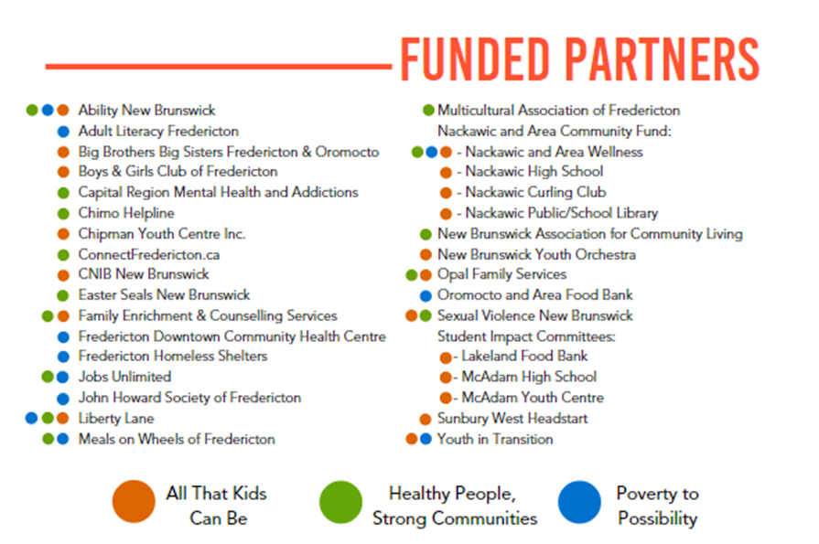
2019 – 2020 UNITED WAY COMMUNITY FUND
INVESTMENTS
Together we are invested in the well-being of our region – together we change lives
Notes:
Always there
Presented by United Way Staff – 30 Sec
Facilitator note: If United Way staff are unavailable, the ECC can present this portion of the agenda.
Objective
To share information scope of funding delivered through out Community Fund – local initiatives
Sample script
Here is a quick snap-shot of how funds raised during last year’s campaign were invested in our region. As you will see, your United Way has provided vital financial support for 32 agencies across 56 different programs that work to help kids be all they can be, create healthy people and strong communities and move us from poverty to possibility. Your United Way makes investments through our Community Fund using a robust screening and vetting process – we have a Community Investment Committee comprised of community volunteers from a wide range of backgrounds and experience to help ensure that we invest your Community Fund where it is needed most and in programs that have proven success.

Slide 10
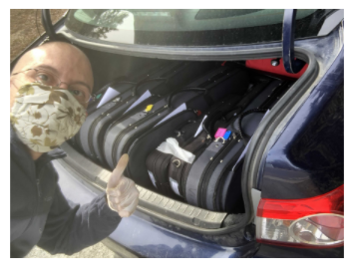
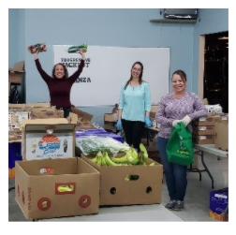
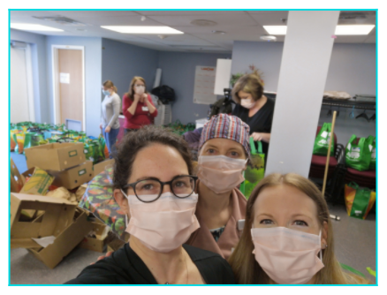
When our community was impacted by COVID-19, we took a leadership role and mobilized emergency relief funds to over 70 programs helping people in crisis across the Central NB region
UNITED WAY 2020 FUNDRAISING CAMPAIGN
Notes:
Impact of COVID-19
Presented by United Way Staff – 30 sec
Facilitator note: If United Way staff are unavailable, the ECC can present this portion of the agenda.
Objective
To share information about the issues resulting from the COVID-19 crisis and how United Way led & supported initiatives to help improve conditions for the most vulnerable
Sample script
When our community was impacted by COVID-19, we faced unprecedented challenges—but were here to meet them head on because our network of community agencies jumped in to take action on the front lines. United Way worked closely wi
Early on in the COVID 19 crisis, a whole host of new barriers and needs emerged. For example, when schools shut down, kids who normally relied on school based meal programs lost access to these important services; counselling services that supported people struggling with mental health or domestic violence could no longer meet their clients; shelters that housed people experiencing homelessness needed to reduce bed #s in order to meet social distancing measures –meaning there were suddenly ½ as many shelter beds. In anticipation of these massive challenges, our United Way hit the ground running in mid-March and have been running ever since to help organize and mobilize our collective community response.

Slide 11
Notes:
Impact of COVID-19
Presented by United Way Staff – 30 sec
Facilitator note: If United Way staff are unavailable, the ECC can present this portion of the agenda.
Objective
To show how United Ways are a tremendous community asset that can quickly mobilize community solutions when needed most.
Sample script.
In general, United Ways are tremendous community assets because they can quickly identify emerging needs and quickly mobilize resources to help when needed most.
For example, in anticipation of the increased need, our local UW (in conjunction with 10 other United Ways from across the Atlantic) immediately launched efforts to provide rapid emergency support to communities via the newly developed Atlantic Compassion Fund (ACF). This joint-effort raised regional awareness to drive financial support and community capacity to support local needs. It was a herculean effort but highly successful! Through these efforts we were able to mobilize over $160,000 and support 55 program adaptations within the first seven weeks of the Emergency Measure Order in our region. Within the first 12 weeks – we funded over 72 initiatives and mobilized over $275,0000 – helping more than 20,000 people!
This sort of detailed and rapid response is why United Ways are so integral to community well-being. United Ways are nimble, collaborative and focused on solutions.
In addition to our early Atlantic Compassion Fund work, the UW of Central NB has continued to mobilize additional supports in partnership with supports from the Government of Canada under the New Horizons Seniors Fund and Emergency Community Support Fund
over $65,000 in seniors specific funding for over a dozen projects;
and have established funding agreements to support an additional 48 Covid-related services over the coming months (totally over $558,000).
Combined, this is $897,000 in community investment and capacity building that will help tens of thousands of folks across our region.

Slide 12
We’re getting through this together.
But there are more challenges ahead.
UNITED WAY 2020 FUNDRAISING CAMPAIGN
Notes:
We’re in this together
Presented by United Way Staff – 30 Sec
Facilitator note: If United Way staff are unavailable, the ECC can present this portion of the agenda.
Objective
To share information about the issues facing our community and what United Way is doing to improve conditions for the most vulnerable
Sample script
We're getting through this together. But there are more challenges ahead
We all have uncertainty about the year ahead and now, more than ever, we need to pull together to support local solutions as challenges emerge.

Slide 13
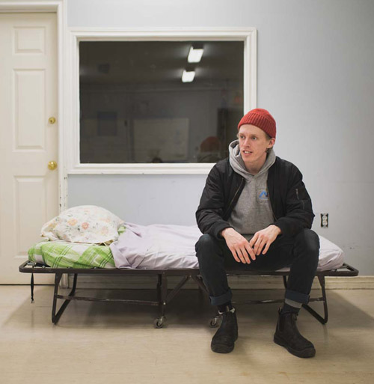
Demand has increased for the services and supports that so many people already rely on.
UNITED WAY 2020 FUNDRAISING CAMPAIGN
Notes:
Demand for services
Presented by United Way Staff – 1 minute
Facilitator note: If United Way staff are unavailable, the ECC can present this portion of the agenda.
Objective
To share information about the issues facing our community and what United Way is doing to improve conditions for the most vulnerable
Sample script
Even before the crisis, unignorable issues like poverty, mental health and addiction, and domestic violence were present in Saint John, Charlotte and Kings. We can’t predict how the future will unfold, but we know there will be increased demand for the services and supports that so many people already rely on. Our community and economy will continue to feel the impact for weeks, months and even years to come. Why? Because:
People who are unemployed will need help getting back to work.
Mental health supports will be more important than ever.
Kids will need even more support with the new dynamics of the education system.
Our community still needs you, like [NEXT SLIDE]

Slide 14
We still need you, now more than ever.
“
We must ensure our network of agencies is here for tomorrow as well. We need your support so that these services can continue to be there for our most vulnerable populations and we can build stronger communities for our future.
Faith McFarland Executive Director, United Way Central New Brunswick
”
UNITED WAY 2020 FUNDRAISING CAMPAIGN
Notes:
We still need you
Presented by United Way Staff – 30 Sec
Facilitator note: If United Way staff are unavailable, the ECC can present this portion of the agenda.
Objective
To share information about the issues facing our community and what United Way is doing to improve conditions for the most vulnerable
Sample script
The effects of this unprecedented global crisis will linger for all of us, and disproportionately affect those people and families who were already vulnerable, and living in poverty, in the first place. Without savings, job security, or employment benefits, many people who are precariously employed are only one paycheque, or one month’s rent away, from poverty. The number of people who face significant barriers--including poverty, mental illness, homelessness and unemployment—will continue to grow and they will need support to overcome these challenges. Your support to United Way helps the agencies on the front lines to keep their doors open, their programs strong and ready for when people need them.

Slide 15
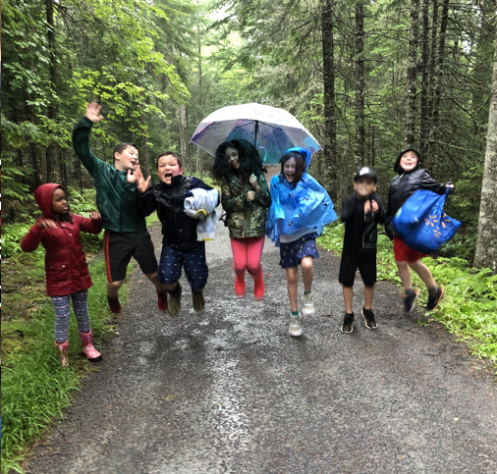
When you give to United Way, you sustain people, families and entire neighbourhoods.
UNITED WAY 2020 FUNDRAISING CAMPAIGN
Notes:
We still need you
Presented by United Way Staff – 30 Sec
Facilitator note: If United Way staff are unavailable, the ECC can present this portion of the agenda.
Objective
To share information about the issues facing our community and what United Way is doing to improve conditions for the most vulnerable
Sample script
When you give to United Way, you sustain people, families and entire neighbouhoods. Donations to the 2019 Community Campaign enabled United Way to support 56 services across our region – these projects help provide a responsible social safety net, ensuring the people and communities they serve continue to have access to critical supports. When you support the United Way Community Fund, you are combining forces with others who invest in building stronger communities through collective giving and collective impact. Many of the positive changes and helpful supports we see operating in our community are United Way powered and supported.

Slide 16
Mental health supports
“[In 2019 – 2020 Chimo responded to 10,743 calls for support] Overall, the results speak to the importance of free, accessible crisis intervention and mental health support through our 24/7 helpline.”
- Chimo Helpline Worker
just one of the United Way powered services that helped change 11,554 lives of people seeking crisis and/or mental health support in our region last year
Notes:
We still need you
Presented by United Way Staff – 30 Sec
Facilitator note: If United Way staff are unavailable, the ECC can present this portion of the agenda.
Objective
To share information about the type of supports and services enabled through participation in workplace giving.
Sample script
When you give to United Way, you help ensure people have access to mental health and crisis supports across our region. Because of donations through our workplace campaigns, last year 11, 554 people benefited from United Way powered mental health and crisis services. This need still exists and will unfortunately continue to grow as a result of our current health crisis. Support for UW helps ensure collective investments in programs like these that will help us weather the challenges ahead.

Slide 17
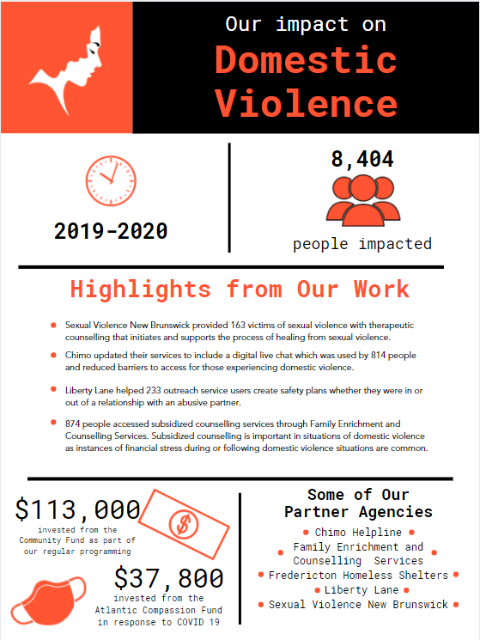
Domestic violence
"I am confident, happy, strong, I love myself, I am not afraid, and I am ready to take on challenges. […] Liberty Lane gave me a home and built me back up...I will be forever grateful for my home here.“
- Liberty Lane Resident/Client
one of the 8,404 lives changed by United Way powered Domestic and Sexual Violence support services in our region in 2019 - 2020
Notes:
We still need you
Presented by United Way Staff – 30 Sec
Facilitator note: If United Way staff are unavailable, the ECC can present this portion of the agenda.
Objective
To share information about the type of supports and services enabled through participation in workplace giving.
Sample script
When you give to United Way, you help support an end to domestic and sexual violence in our region. Because your United Way, our region has been able to fund and support many domestic and sexual violence related programs and services that help provide options for people who are being victimized.
Not many of us would recognize how great the need is in this area – however….
In the Atlantic provinces, NB has the highest rate of police-reported cases of IPV (Love Shouldn’t Hurt Campaign, Government of Canada, 2013).
NB has the highest rate of death from IPV than the other Atlantic provinces (Love Shouldn’t Hurt Campaign, Government of Canada, 2013).
Compared to the rest of Canada, NB has the highest rate of family-related murder-suicides (Love Shouldn’t Hurt Campaign, Government of Canada, 2013).
During the Covid 19 lockdown many of our partners reported sharp increases in domestic violence related crisis calls in our region – the need is great but so too is our ability to turn the tide on this issue.

Slide 18
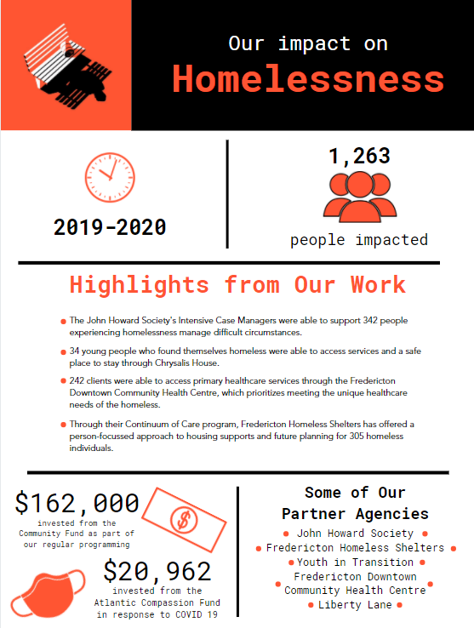
Homelessness
Canadian studies have proven that ending the cycle of homelessness is less expensive and more effective than the status quo (providing short-term emergency services). Last year, local Housing First services moved 69 people out of homelessness and saved an estimated thousands of dollars in emergency services like hospital stays, emergency room visits and policing.
- Community Action Group on Homelessness Member
reflections on United Way supported Housing First services in 2019 - 2020
Notes:
We still need you
Presented by United Way Staff – 30 Sec
Facilitator note: If United Way staff are unavailable, the ECC can present this portion of the agenda.
Objective
To share information about the type of supports and services enabled through participation in workplace giving.
Sample script
When you give to United Way, you help support an end to homelessness – not just in the short-term but also an end to long-term persistent homelessness.
As a result of many factors, we are seeing a rise in street homelessness in our region and a steep rise in the duration of homelessness. Rising housing costs and lower vacancy rates has made it much more difficult for people to maintain safe housing or re-enter housing after an episode of homelessness.
As a United Way we are committed not only to supporting access to important emergency services (like shelters, out-reach and drop-ins) but are also working with community to end homelessness. We show this support through our involvement in collaborations like like the Mayor’s Taskforce on Homelessness, The Community Action Group and the City of Fredericton’s Affordable Housing Committee. More specifically, we are proud to fund evidence-based programs proven to end the cycle of homelessness (like Intensive Case Management) and the creation of purpose-built housing for people escaping chronic homelessness. Communities before us have proven it is possible to end long-term homeless through similar coordinated efforts. We can and must do better.
However, as we work toward long-term changes we are still seeing growing needs. For example in the winter of 2018-19, our community had to open its first ‘out of the cold’ shelter (a temporary shelter of last resort) to help address the urgent need. Sadly, 100 different people had to access a bed at that out of the cold and sadly, it had to open again in the winter of 2019-2020 – but thankfully, our community rallied together to make this safe port available to people left with no option but to sleep outside or in cars, As a United Way, we were proud to be part of these emergency measures.
housing efforts domestic and sexual violence in our region. Because your United Way, our region has been able to fund and support many domestic and sexual violence related programs and services that help provide options for people who are being victimized.
Not many of us would recognize how great the need is in this area – however….
In the Atlantic provinces, NB has the highest rate of police-reported cases of IPV (Love Shouldn’t Hurt Campaign, Government of Canada, 2013).
NB has the highest rate of death from IPV than the other Atlantic provinces (Love Shouldn’t Hurt Campaign, Government of Canada, 2013).
Compared to the rest of Canada, NB has the highest rate of family-related murder-suicides (Love Shouldn’t Hurt Campaign, Government of Canada, 2013).
During the Covid 19 lockdown many of our partners reported sharp increases in domestic violence related crisis calls in our region – the need is great but so too is our ability to turn the tide on this issue.

Slide 19
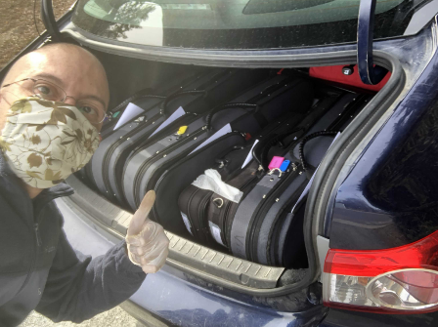
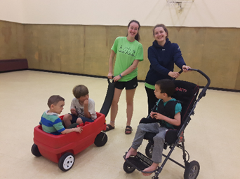
Help kids be all they can be
“[Your grant] will be used […] in serving disadvantaged children on the northside of Fredericton, a priority neighbourhood with a demonstrated need. Your partnership in orchestrating change for disadvantaged children and families in Fredericton
- Sistema Youth Orchestra
On United Way’s Community Fund grant in 2019-2020
Then, near the end of the summer, he grabbed a toy train and went over to join other children his age playing with trains as well. They all sat quietly and played together for around thirty minutes, passing toys back and forth and building tracks for their trains cooperatively. This interaction was the first time that this camper had every shown interest in playing with others his age.
- Opal Family Services
Reflections on United Way funded summer programming for children with special needs
Notes:
We still need you
Presented by United Way Staff – 30 Sec
Facilitator note: If United Way staff are unavailable, the ECC can present this portion of the agenda.
Objective
To share information about the type of supports and services enabled through participation in workplace giving.
Sample script
When you give to United Way, you are also helping kids be all they can be. Today’s kids are tomorrow’s leaders. When kids grow up emotionally and socially healthy, it carves the way for a brighter future, benefiting our entire community. A child’s future health, learning, and behaviour begin to develop in their early years, so failure to reach developmental milestones—such as the ability to communicate, regulate emotions, and maintain relationships—can have long-term effects on a child’s confidence and competency to succeed. Despite how vitally important children are to our shared-welling being, an alarming number of children are facing incredible barriers to success. For instance, here in NB is almost 17% higher than the national average (21.7% NB Child Poverty Rate) with some neighbourhoods, communities and populations much higher than that – for instance, the most recent census shows us that 37% of Indigenous children in NB are living in poverty – many would be shocked to learn that 48% of children in Fredericton’s Ward 4 are living in poverty. For this reason, key investments are needed in priority populations and neighbourhoods to ensure we help children reach their fullest potential. We are proud to support programming that not only helps kids and families overcome economic barriers but programming that promote inclusion of children with special needs. This is important and valuable work.

Slide 20
Our promise to you
We will:
Partner with local government and our network of agencies
Continue to invest your donations in organizations that show a proven impact in the lives of people in our communities
Act as a trusted partner in administering federal funding
Leverage research and policy insights
Continue to make issues #unignorable, build capacity for change, and roar for our community.
UNITED WAY 2020 FUNDRAISING CAMPAIGN
Notes:
Our promise to you
Presented by United Way Staff – 1 minute
Facilitator note: If United Way staff are unavailable, the ECC can present this portion of the agenda.
Objective
To share information about the issues facing our community and what United Way is doing to improve conditions for the most vulnerable
Sample script
United Way is committed to putting your donations to work in the most effective way possible, putting your dollars to work in the community when, and where, they’re needed most. We’ll continue to provide a vital continuum of care for people and families whose lives have been turned upside down by this global crisis. We’ll respond, in real-time, to urgent needs on the ground, and plan for future challenges. We will continue to:
Partner with local government and our network of agencies to ensure there are no gaps in services or needs unmet
Provide funding to our agencies so they have the resources they need to keep doors open and meet rising demand, and provide support, guidance, and training to help them navigate challenges through this time.
Act as a trusted partner in administering federal funding
Leverage research and policy insights to ensure strategic action in our communities and ensure the long-term strength and prosperity of the people and communities we serve.
Continue to bring to light and advocate for change in the #unignorable issues facing out region.

Slide 21
Please give generously today. Your gift will help keep our community strong, connected and supported today and for years to come.
We are in this together.
And together we are stronger.
UNITED WAY 2020 FUNDRAISING CAMPAIGN
Notes:
Please Give Generously
Presented by CEO/ECC – 1 minutes
Objective
To make a clear call to action for giving to United Way
To provide the CEO and ECC the opportunity to thank employees for their participation
Sample script
Thank you for joining us today!
By participating in our fundraising campaign, you are helping people who need it most, connecting them to the resources and supports they need to thrive.
Now more than ever, it is important that we come together as a community – United Ways not only fund vital programs, but they also give us as individuals an avenue to come together in a ‘united way’ to support collective investments in our local community. When you receive your link to donate, your gift will help us to continue to play this much needed role in our region.
Thank you again for your time and participation, and I look forward to celebrating our fundraising success!

Slide 22
Join us in our 2020 United Way Campaign
Make your pledge on [DATE]
Participate in [EVENT]
Join us for our campaign wrap-up celebration on [DATE]
UNITED WAY 2020 FUNDRAISING CAMPAIGN
Notes:
Next steps / Campaign Schedule
Presented by ECC – 1 minute
Objective
To provide next steps/instructions on how to give and participate in campaign
Sample script
We hope you will join us in making a difference in our community. In a time when so many are struggling, we are fortunate to be able to give back. Every dollar donated and every minute spent has the ability to make a real and tangible difference in the lives of so many. And this year, even if we are working remotely, there are lots of ways you can join us in helping others, including learning more about community issues, participating in activities and events and making a donation, if you are able to do so. This year, I will be making a donation because [insert personal reasons for giving] and I hope you will too.

Slide 23
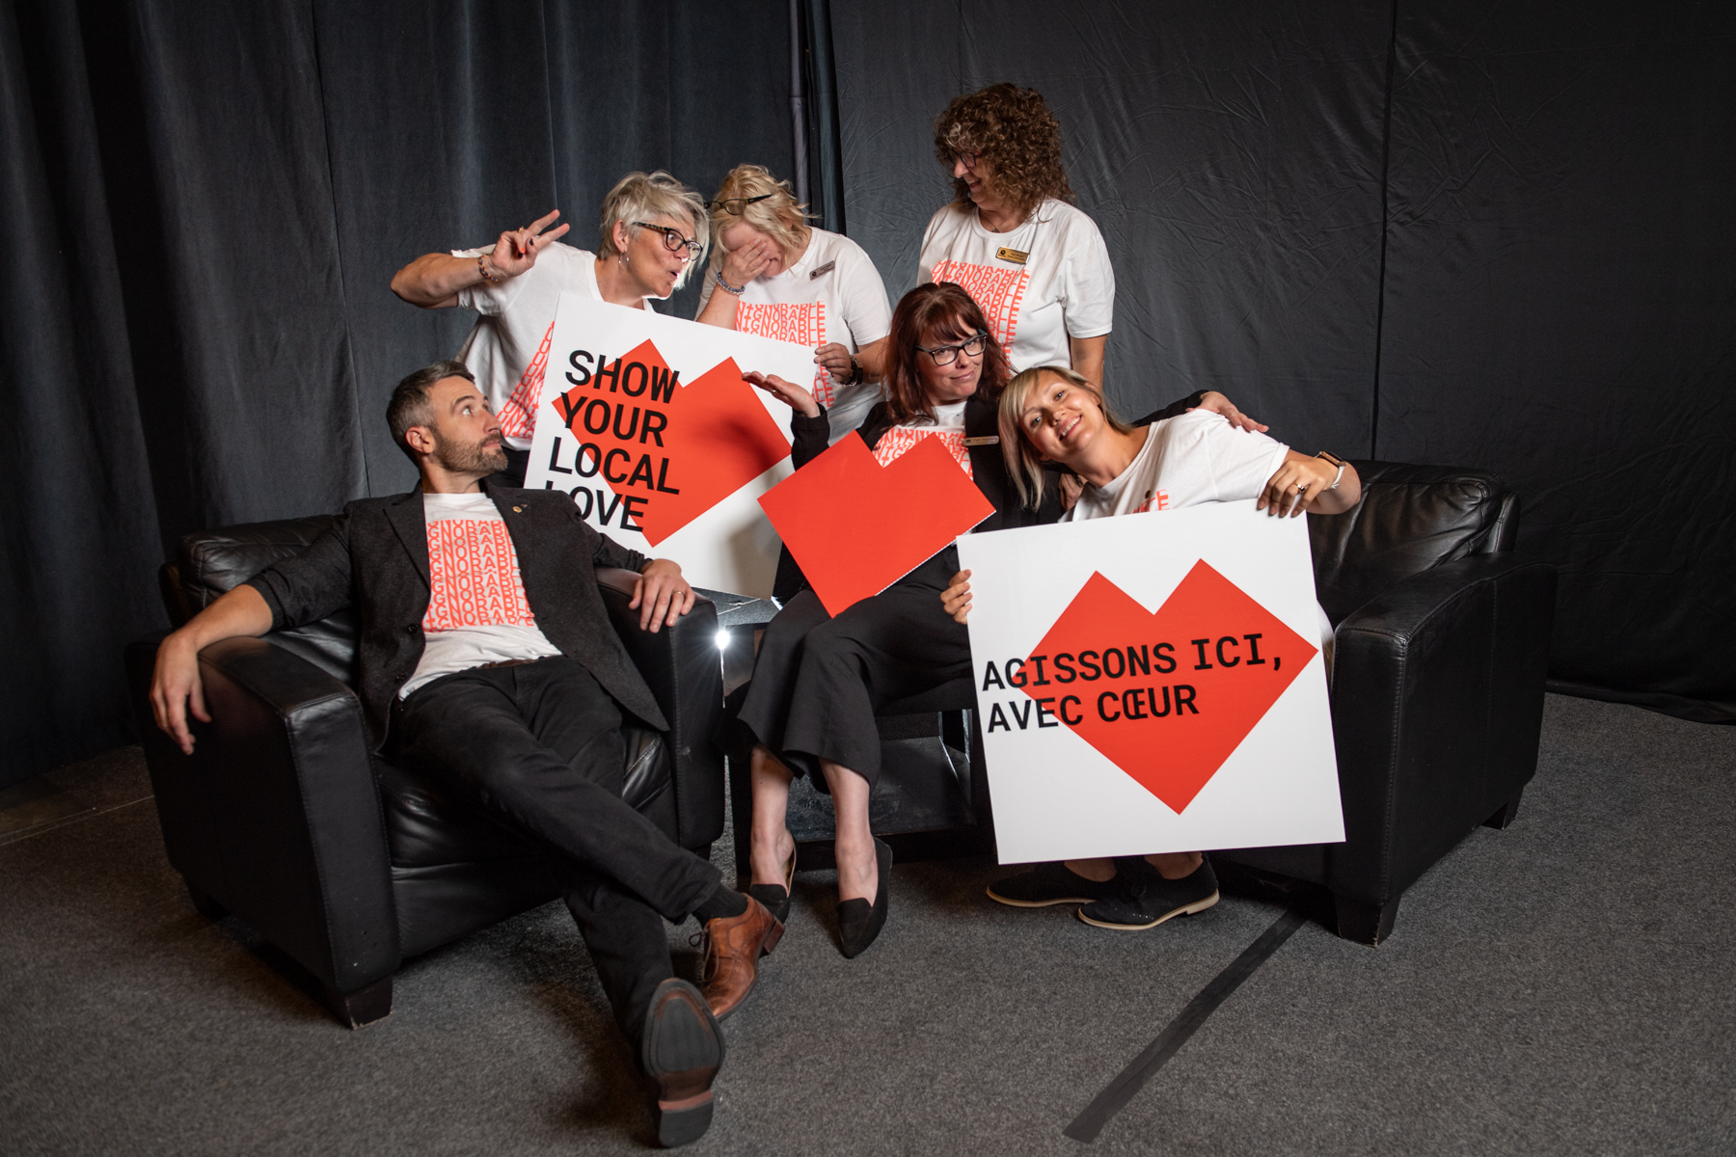
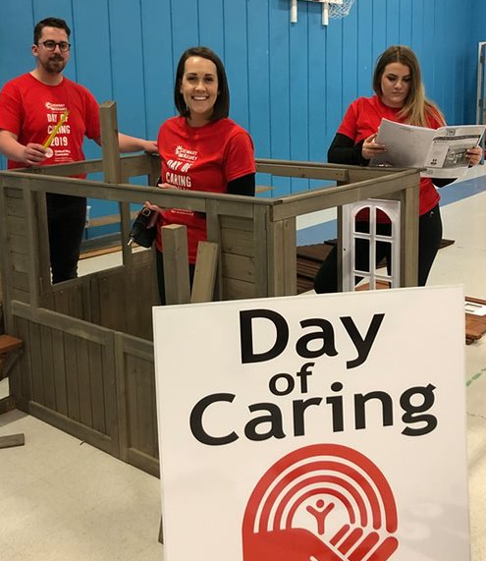
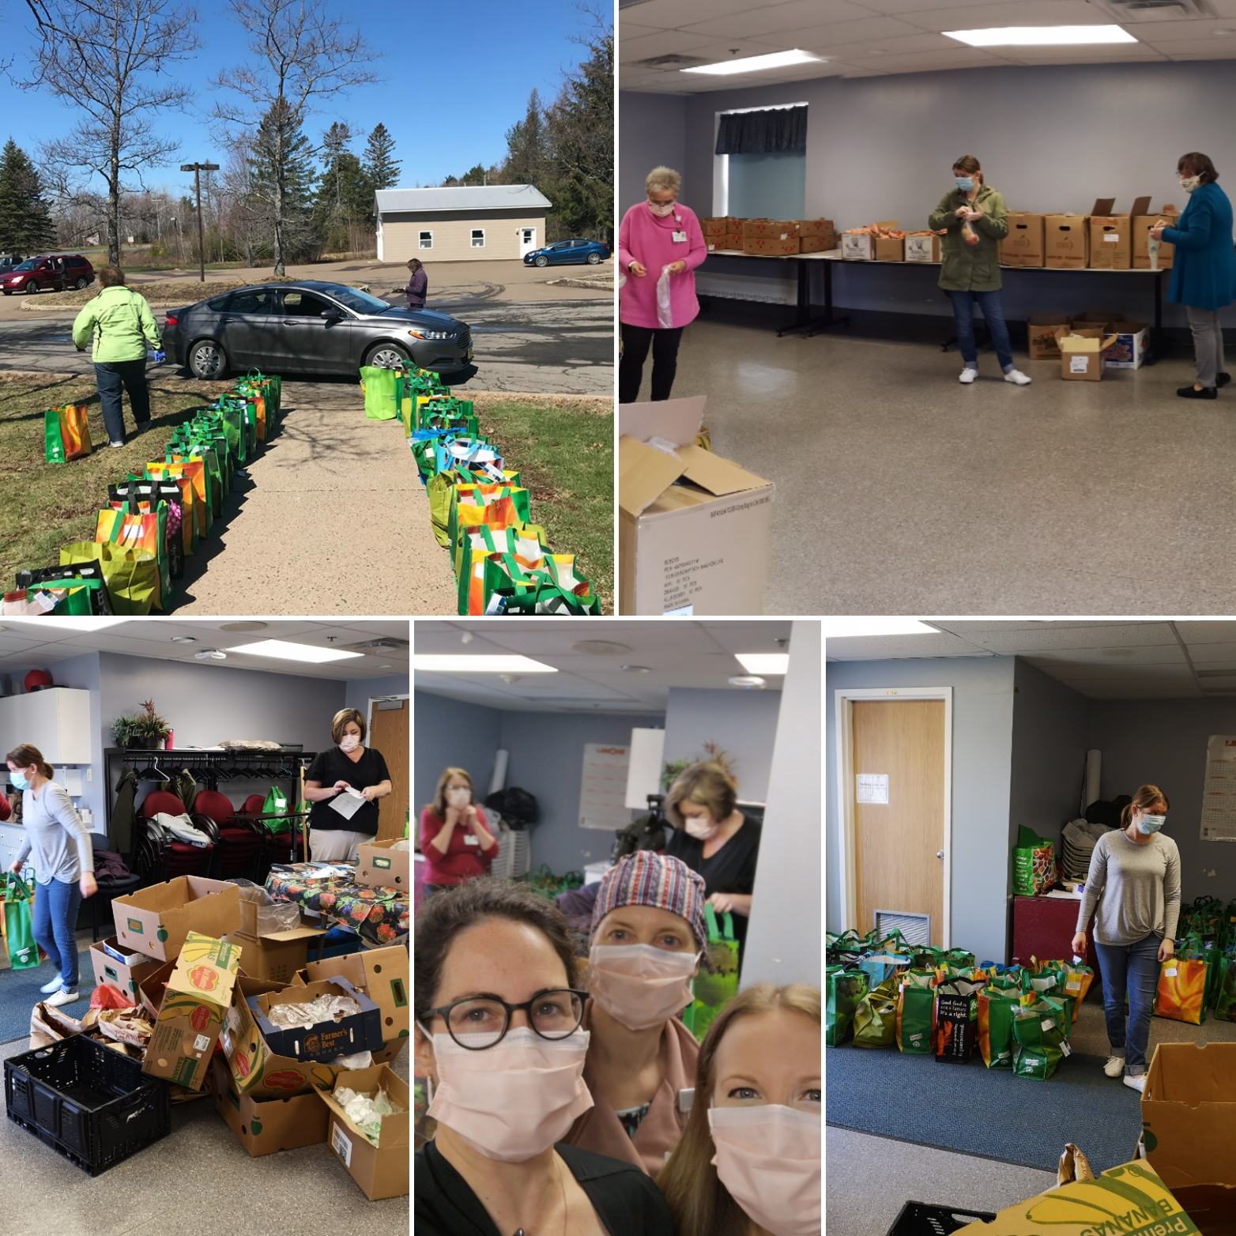
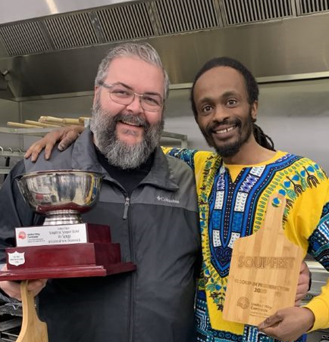
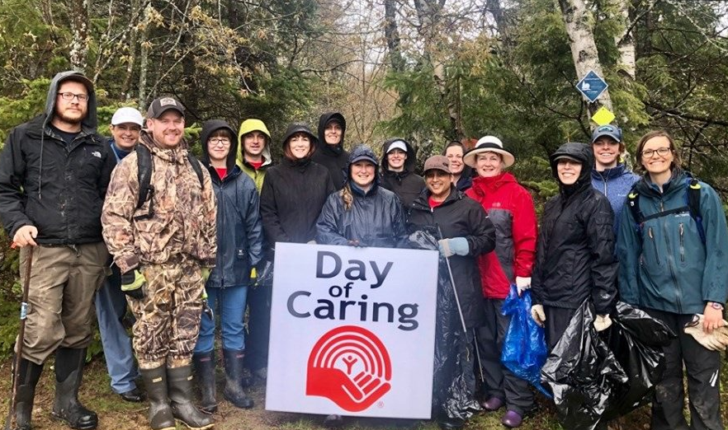
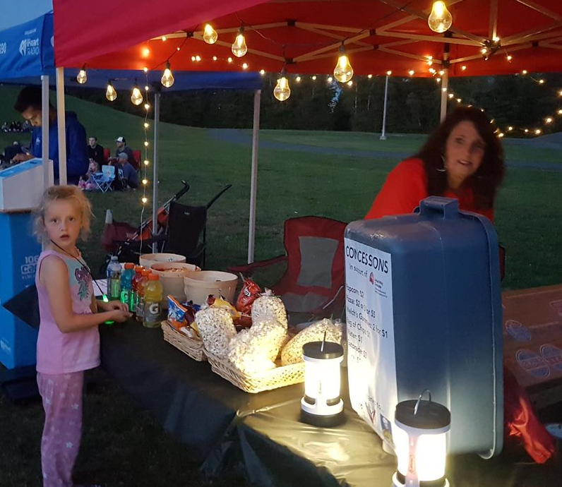
THANK YOU
Notes:
Thank you
Presented by ECC – 1 minute
Objective
To thank participants for attending
To let them know their pledge link will be arriving in their inboxes shortly
Sample script
Thank you to all who joined us today and helped us better understand our community and what we can do to make a difference. United Way plays a critical role in maintaining the social safety net that so many rely on. By partnering with them on this campaign, we are also helping to make this vital network of support stronger, so it’s there for those that need it, today and in the years to come.
Facilitator note: With remaining time, the floor can be opened for questions about the company’s campaign, or questions about United Way’s work (United Way staff can help answer these questions).

