Slide 1

Government of Canada Workplace Charitable Campaign (GCWCC)
NATIONAL DEFENCE WORKPLACE
CHARITABLE CAMPAIGN 2020
Notes:
Thank everyone for attending
-Introduce yourself. Name, years with base, how many years being a Unit Rep. Excited for our upcoming NCWCC 2020 Campaign.

Slide 2
What is the NDWCC?
Federal government employees and retirees proudly support Canadian communities and their needs through the Government of Canada Workplace Charitable Campaign (GCWCC).
National Defence Workplace Charitable Campaign (NDWCC):
  Canadian Armed Forces (CAF) – regular Force members; Reserve Force members; and civilian employees
The is managed by United Way Centraides across the country with the named charities of choice being United Way and Health Partners.
Since its inception in 1997, the GCWCC has become the largest workplace charitable campaign in Canada.
Notes:
-Recap slide
-Workplace campaigns are an integral part of civil society.
-It is about coming together as a community
-Each if us are giving in our own way whether its is contributing through volunteering or donating to a charitable giving campaign
-As a collective whole we are making an incredible impact-never underestimate it
******
The economic impact of this sector cannot be overstated. Charities and nonprofits contribute over $150 billion to our national economy each year, representing 8.1 per cent of our GDP. In recent years, this sector’s growth has outpaced that of the overall economy by an astounding 2 percent. It employs nearly 2 million Canadians and receives 2 billion volunteer hours from Canadians each year, equal to 1 million additional full-time jobs.
The Department of National Defence (DND) and the Canadian Armed Forces (CAF) make up the largest federal government department. Under Canada’s defence policy, the Defence Team will grow to over 125,000 personnel, including:
71,500 Regular Force members (from 68,000)
30,000 Reserve Force members (from 27,000)
25,000 civilian employees (from 24,000)

Slide 3



Local scope
Hyper-local & community based
Focus on providing programming and services in our region:
  Poverty/homelessness
  Employment/education
  Social inclusion
  Mental Health
  Women's protection and outreach
National scope
Broad reaching
Focus on providing public education and health services nationally:
  Heath research
  Health-based supports
  Education
  Advocacy
Through the GCWCC, donors can choose to support United Way Centraide, HealthPartners and/or any other Canadian registered charity.
Notes:
-As you can see United Way & Health Partners each have their unique scope and ability to engage individuals
United Way-is very focused on a local scope and our community
Health partners-is focused on a national scope and broad reaching

Slide 4

















HealthPartners is a unique partnership of 16 health charities.
Notes:
Health Partners is a unique partnership of 16 of the most respected health charities in the country. Their workplace fundraising efforts generate vital resources in order to:
-develop new and better treatments that may save lives
-improve the quality of life of people affected by the disease and their loved ones, through targeted programs and services
-raise awareness and prevent illnesses by promoting ways to achieve a healthy lifestyle
*****
HealthPartners-Quebec is a unique partnership of 16 of the most respected health charities in the country. Our workplace fundraising efforts generate vital resources in order to:
• develop new and better treatments that may save lives;
• improve the quality of life of people affected by disease and their loved ones, through targeted programs and services;
• raise awareness and prevent illnesses by promoting ways to achieve a healthy lifestyle.

Slide 5
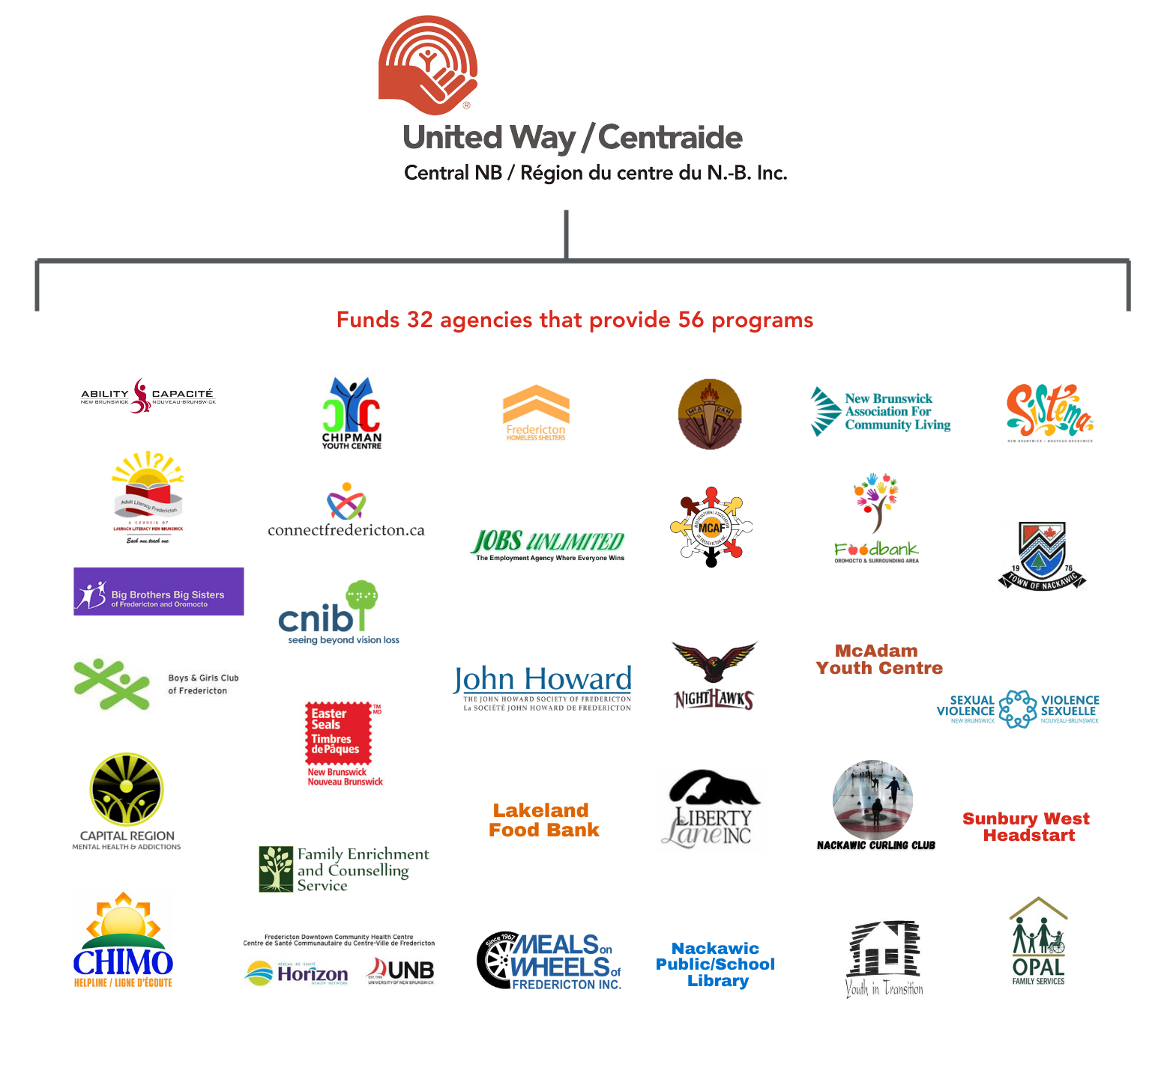
Notes:
-United Way Central NB is partnering with 32 local agencies that provide 56 programs to those in need
-Our fundraising efforts help us focus on: Mental Health, Poverty, Social Isolation, Domestic Violence, Hunger, Education, Unemployment, Homelessness

Slide 6
Health Partners Video
https://www.youtube.com/watch?v=TJHGWmyYjEA&t=2s

Slide 7




Health Partners Scope
16 National Health Charities
1,200 communities across Canada
Raised since 1988 for life-changing research, as well as a wide range of programs and community support
$178-million
Notes:
-recap the whole slide (charity number, communities in Canada, amount raised)

Slide 8
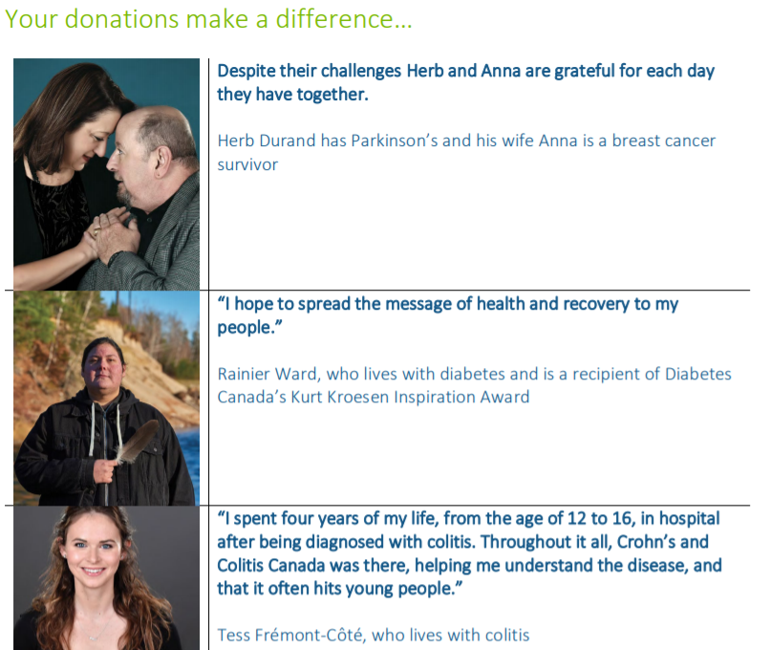
How Can We Help?
In addition to raising funds, HealthPartners also provides year-round programs and services in workplaces to improve the health outcomes of employees across the country.
Through our 16 charities and the more than 400 diseases they represent, we have developed causes that reflect what is important to the health of employees and employers such as:
• Mental health and chronic disease • Women and men’s health • Caregivers • Preventative health information like proper nutrition and the benefits of physical exercise
Notes:
Health Partners provides:
-Counseling to someone who has been diagnosed with Alzheimer’s
-Helps with teaching parents of a child with Cystic Fibrosis (CF) how to clear their child’s lungs
-Assist with providing specialized bathroom equipment for someone with ALS
-1 in 4 people have high blood pressure which can lead to a heart attack or stroke
-In NB, 5 ppl die of cardiovascular disease everyday
-Approximately 17,000 ppl in NB live with Alzheimer’s

Slide 9

United Way Video
https://www.youtube.com/watch?v=zdRrwAF0DkE&t=14s

Slide 10

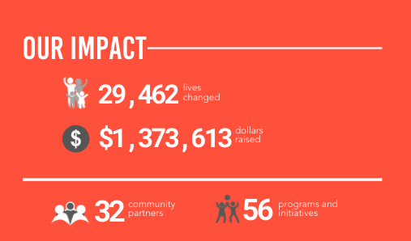
As a result of our 2019 campaign…
Notes:
As a result of our 2019 campaign
-recap the slide stats (lives changes, dollars raised, community partners and programs and initiatives)

Slide 11
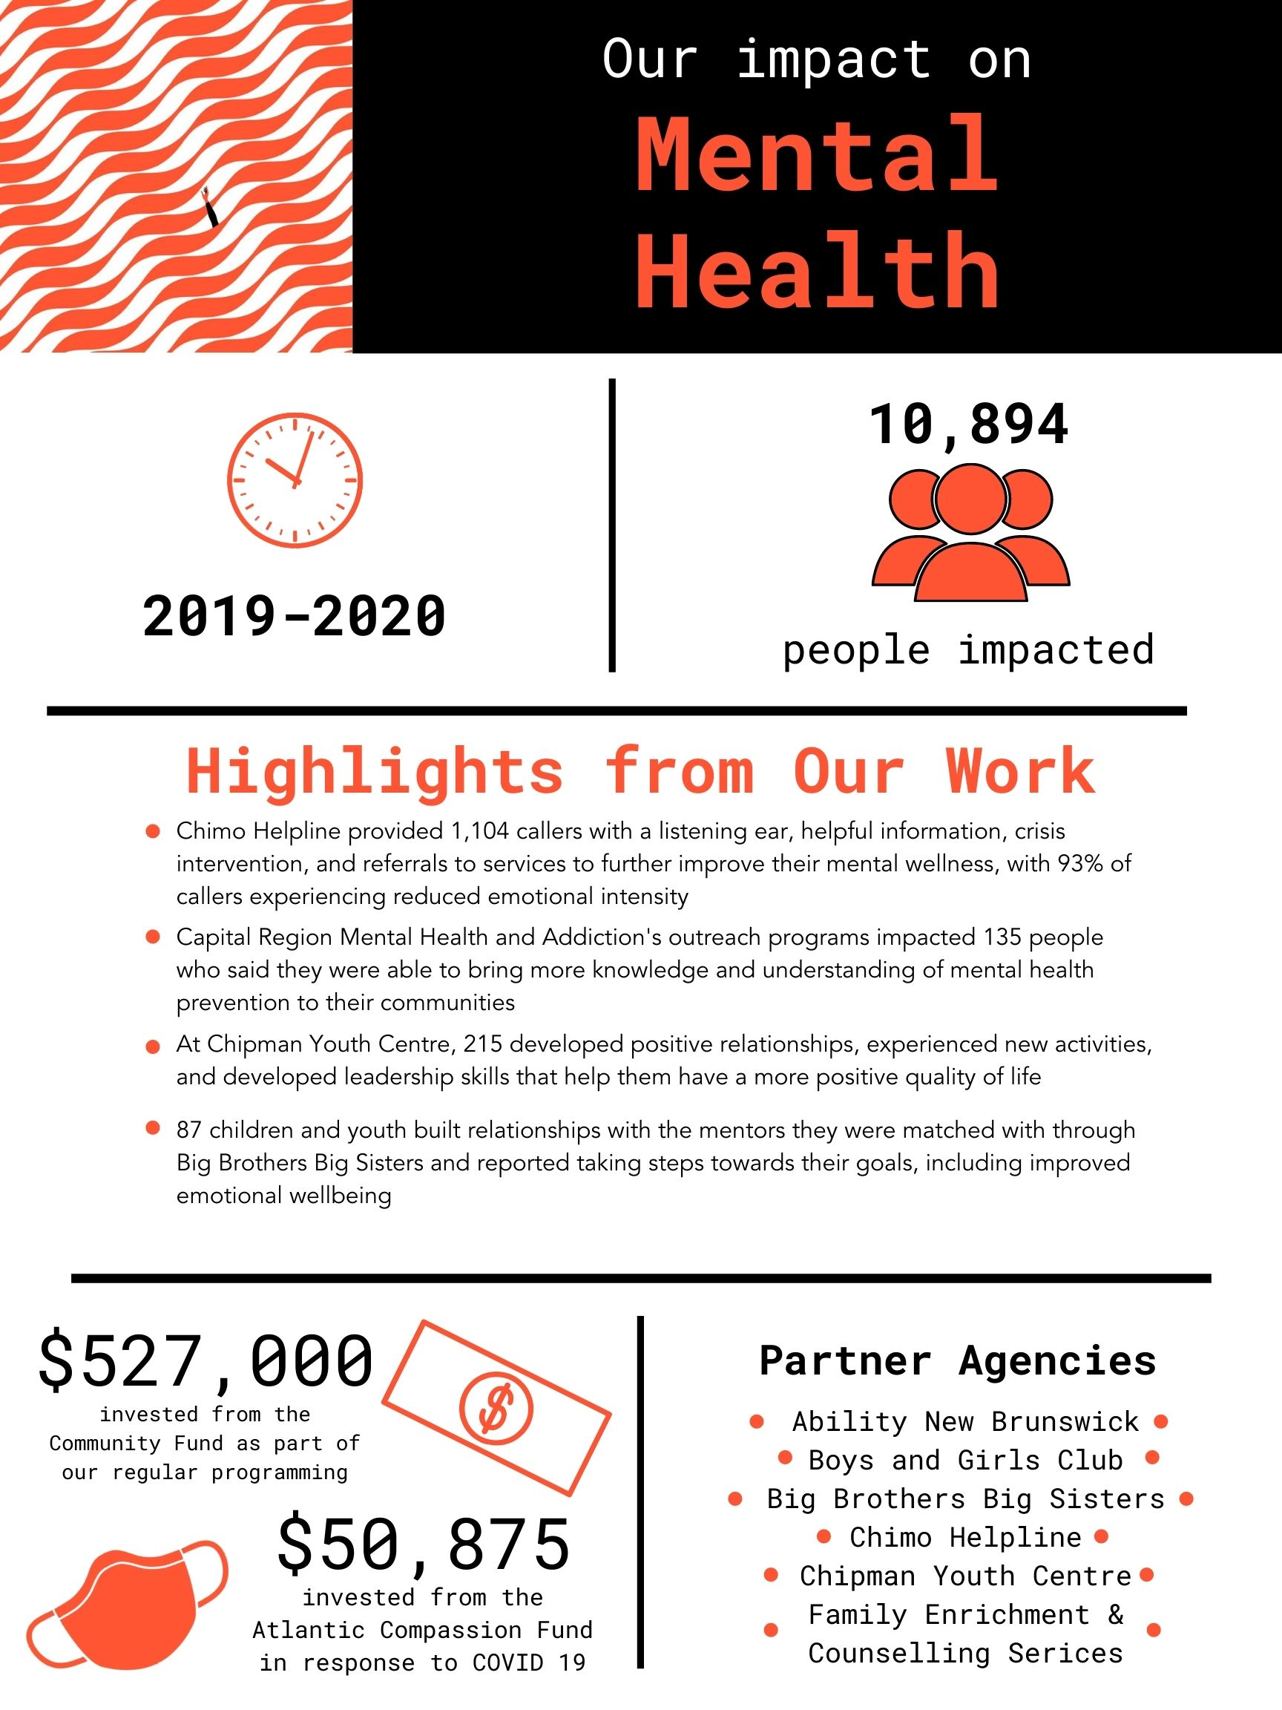
Notes:
With only a few minutes I decided to focus on mental health and domestic violence. These issues have become more apparent over the years:
United Way’s impact on mental health was outstanding in 2019-2020
-As you can see 10,894 individuals impacted
Major highlights were:
- Chimo helpline is fantastic for anyone needing a listening ear, helpful information, crisis intervention and referrals to services. They are available 24/7.
- Capital Region Mental Health & Addictions outreach programs helped people feel more knowledgeable and understanding of mental health
- Chipman Youth Centre developed relationships, experienced activities and leadership skills that they mentioned youth felt they had a positive quality of life
- Big Brothers big Sisters-youth felt more connected and they felt they moved towards goals which improved their emotional well-being
$527,000 invested from the Community Fund from the past fundraising year!
$50,875 from Atlantic Compassion Fund which began mid-March due to COVID-19 responses!
Many agencies are partnered with us regarding mental health such as:
- Ability NB
- Boys and Girls Club
- Big Brothers Big Sisters
- Chimo Helpline
- Chipman Youth Centre
- Family Enrichment Counselling Services

Slide 12
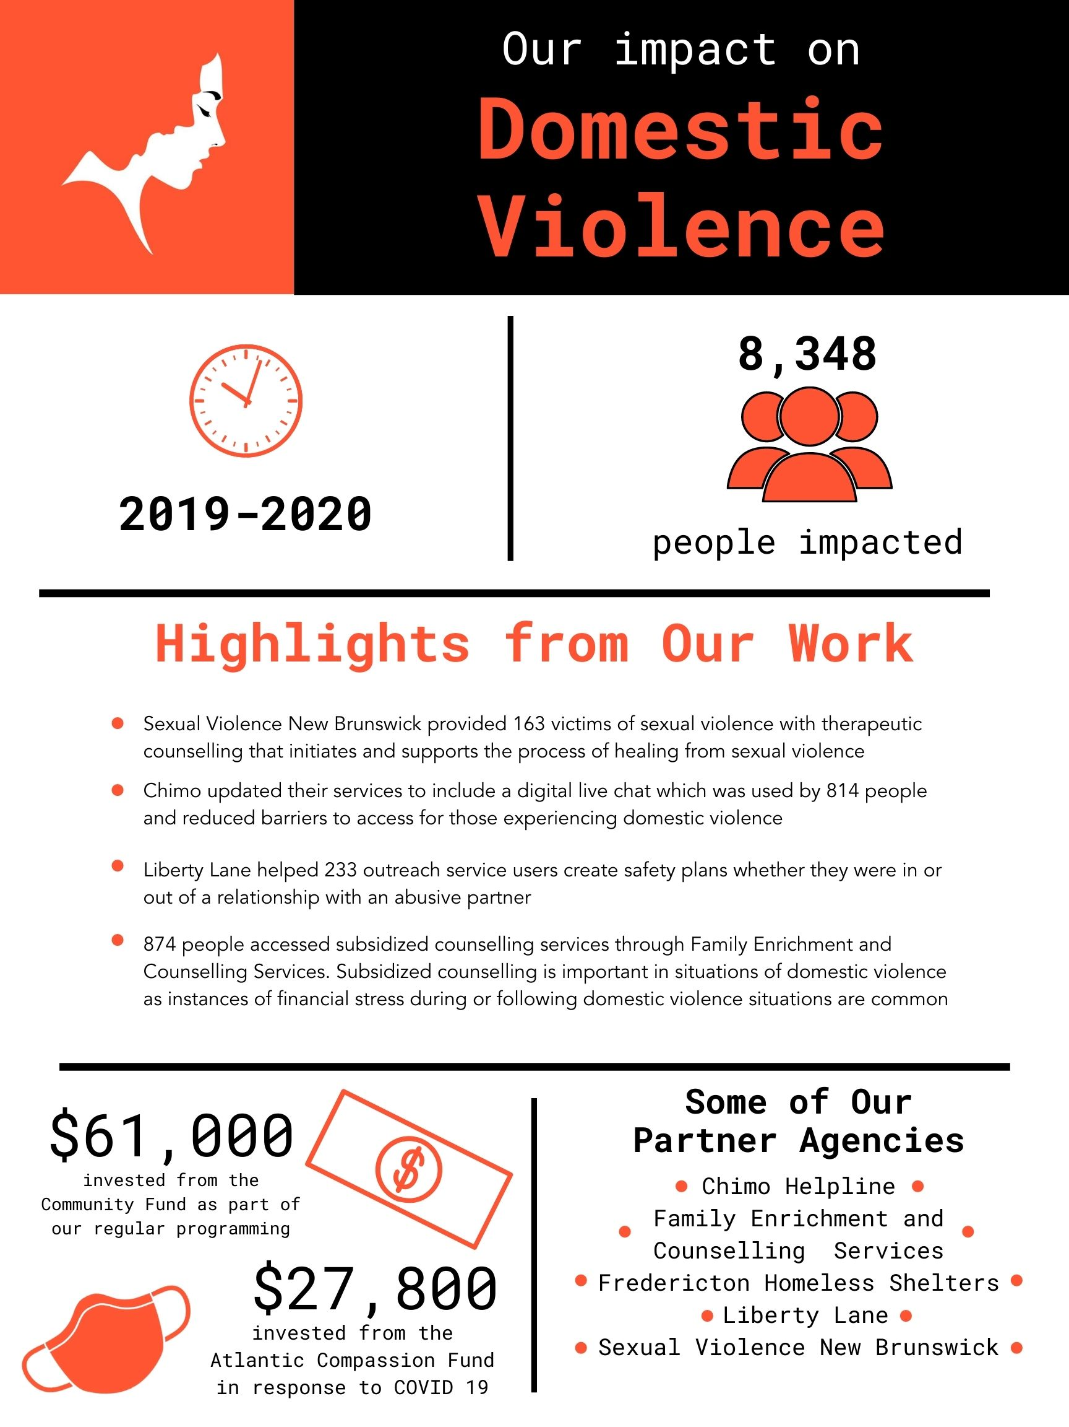
Notes:
United Way’s Impact on Domestic Violence was outstanding as well for 2019-2020
As you can see 8,348 people were impacted
Major highlights were:
Sexual Violence New Brunswick helped provide therapeutic counselling to those in need
Chimo updated their services and created a live chat option to reduce barriers to access help for those experiencing domestic violence
Liberty Lane helped create safety plans for partners in or out of a relationship with an abusive partner
Family Enrichment provided counselling services at a subsidized fee. Extremely important for those that left an abusive relationship.
$61,000 invested from Community Fund from the past fundraising year!
$27,800 invested from the Atlantic Compassion Fund in response to COVID-19

Slide 13



Thank you!
You make a major difference in the lives
of thousands of people
in our communities
Notes:
-We are often unaware of local issues that impact our community and quite possibility people we know
-Recap slide
-Thank you for letting us present and wish you all the best with your coming campaign

